Slide 1
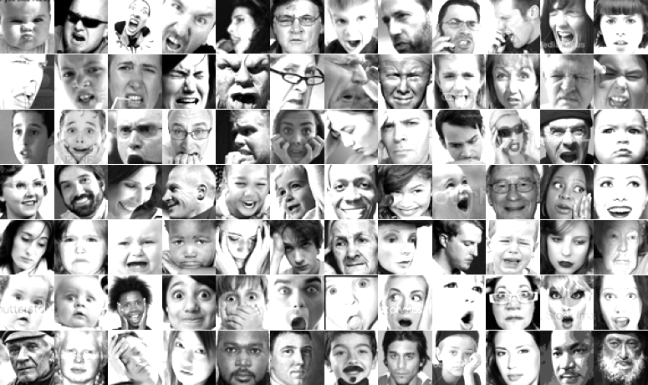
EMOTIONS DECODED
The Power of CNNs in Facial Expression Recognition
TEAM 1
Priya Iragavarapu
Francesca Scipioni
Sowjanya Yaddanapudi
Omar Zu'bi
DATASCI 207 - Section 4
August 17th, 2024
University of California
Berkeley
KAGGLE
Challenges in Representation Learning: Facial Expression Recognition Challenge.
Notes:
Sowjanya

Slide 2











PROJECT OVERVIEW
Exploring the Key Aspects and Milestones of Our Emotion Classification project
ACCURATE EMOTION CLASSIFICATION
Our project focuses on detecting facial expressions using Convolutional Neural Networks (CNNs) to classify emotions from facial images.
7
EMOTIONS
ANGRY
DISGUST
FEAR
HAPPY
SAD
SURPRISE
NEUTRAL
LARGE REAL-WORLD APPLICATIONS
The ability to accurately recognize human emotions through facial expressions has vast implications across multiple domains:
● CUSTOMER SERVICE ● HEALTHCARE ● SECURITY ● EDUCATION
OBJECTIVES
&
MOTIVATION
EMOTION CLASSIFICATION AS AN INSPIRING CHALLENGE
By tackling the complexities of human emotions, this project pushes the boundaries of AI capabilities and offers valuable insights into human behavior.
ADVANCING TECHNOLOGY IN AI
Developing robust emotion classification models contributes to the broader field of AI, enhancing machine learning techniques and fostering innovation in technology.
FOSTERING EMOTIONAL INTELLIGENCE
Implementing emotion recognition in AI systems enhances their ability to understand and respond to human emotions, leading to more emotionally intelligent interactions and improved user satisfaction.
Notes:
Sowjanya

Slide 3
PROJECT OVERVIEW
Exploring the Key Aspects and Milestones of Our Emotion Classification project
ACCURATE EMOTION CLASSIFICATION
Our project focuses on detecting facial expressions using Convolutional Neural Networks (CNNs) to classify emotions from facial images.
EXECUTIVE SUMMARY
Our analysis revealed varying accuracies between the models with and without data augmentation. Specifically, the model with augmentation achieved an accuracy of 61%, while the model without augmentation reached an impressive accuracy of 84%, providing intriguing insights into the effects of data enhancement on performance and its applications.
OBJECTIVES
&
MOTIVATION
LARGE REAL-WORLD APPLICATIONS
The ability to accurately recognize human emotions through facial expressions has vast implications across multiple domains:
● CUSTOMER SERVICE ● HEALTHCARE ● SECURITY ● EDUCATION
EMOTION CLASSIFICATION AS AN INSPIRING CHALLENGE
By tackling the complexities of human emotions, this project pushes the boundaries of AI capabilities and offers valuable insights into human behavior.
ADVANCING TECHNOLOGY IN AI
Developing robust emotion classification models contributes to the broader field of AI, enhancing machine learning techniques and fostering innovation in technology.

Slide 4


OVERVIEW
Our project focuses on detecting facial expressions using Convolutional Neural Networks (CNNs) to classify emotions from facial images. Our analysis revealed varying accuracies between the models with and without data augmentation. Specifically, the model with augmentation achieved an accuracy of 61%, while the model without augmentation reached an impressive accuracy of 84%, providing intriguing insights into the effects of data enhancement on performance and its applications.
EXECUTIVE SUMMARY
CUSTOMER SERVICE
Personalized Interactions
Real Time feedback
HEALTHCARE
Mental health Monitoring
Therapeutic Tools
SECURITY
Surveillance
Access Control
EDUCATION
Adaptive learning
Skill Development
APPLICATIONS

Slide 5
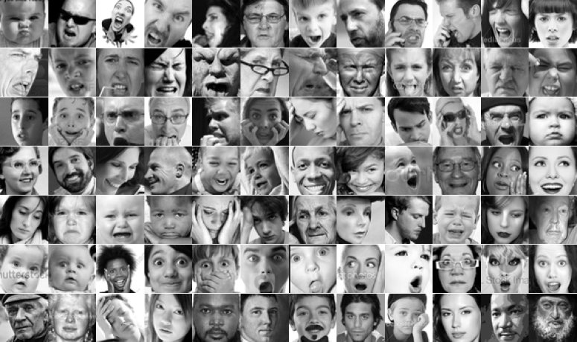
EXPLORATORY DATA ANALYSIS
In-Depth Data Exploration to Inform Model Development
SAMPLE IMAGES PER EMOTION
The dataset contains 48x48 pixel grayscale images of faces.
RESOLUTION
The faces have been registered to ensure they are centered and occupy the same amount of space in each image
UNIFORMITY
Some images include hands, which can enhance the perception of the emotion by providing context.
HANDS
IMPLICATIONS FOR CLASSIFIER PERFORMANCE
The presence of hands introduces additional features that could aid or hinder the classifier’s emotion detection.
INFLUENCE
Head positions and associated features provide additional cues, potentially improving the classifier’s accuracy.
Variability in head positions and features may introduce noise, making it harder for the classifier to focus on facial expressions.
ENHANCED CUES
INCONSISTENCY
Notes:
Sowjanya

Slide 6
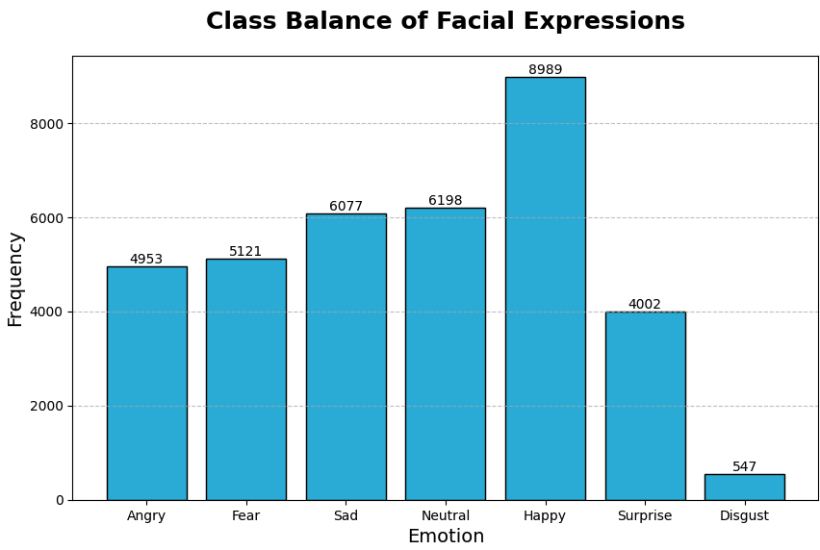
EXPLORATORY DATA ANALYSIS
In-Depth Data Exploration to Inform Model Development
HISTOGRAM OF EMOTION LABELS DISTRIBUTION
Show the distribution of the emotion labels.
DISTRIBUTION
Investigate class imbalance.
IMBALANCE
Balanced dataset crucial for training a robust model.
BALANCE
Over Represented Class
IMPLICATIONS OF CLASS IMBALANCE
MODEL BIAS
Accuracy can be misleading in class-imbalanced datasets, reflecting success in predicting the majority class while ignoring minority classes.
Training a model on imbalanced data might bias towards the majority class (“Happy”).
Underrepresented classes aren’t learned effectively causing poor accuracy.
POOR PERFORMANCE
MISLEADING ACCURACY
Under Represented Class
Severe class imbalance between the different emotion classes
Notes:
Sowjanya

Slide 7
MODELING
Without Data Augmentation
WHEN TO AVOID DATA AUGMENTATION
In image classification
Data augmentation techniques may not be appropriate in the following situations:
HIGHLY CONTROLLED ENVIRONMENTS
SMALL DATASETS WITH HIGH QUALITY
PERFORMANCE WITH AUGMENTATION DECLINES
COMPUTATIONAL CONSTRAINTS
MODELING APPROACH
Strategies
The selected dataset consists of
48 X 48 HIGH-QUALITY IMAGES OF FACES
IMAGES ALSO CONTAIN HANDS THAT ENHANCE THE EMOTION
Employment of data augmentation is controversial. We decided to test two modeling strategies:
MODELING WITHOUT AUGMENTATION
MODELING WITH AUGMENTATION
ADDITIONAL STEPS
Performed in our models
Alternate strategies we performed on the dataset without augmentation are:
DATA CLEANSING & PRE-PROCESSING
We ensured the dataset was free from errors and inconsistencies, and normalized the images for uniformity.
CLASS IMBALANCE HANDLING
We oversampled the number of instances in the smallest class to address the imbalance among emotion classes, ensuring more reliable model performance.
Notes:
Pryia

Slide 8
MODELING
Without Data Augmentation
BASELINE MODEL
ARCHITECTURE & MODEL PERFORMANCES
HYPERPARAMETER-TUNED MODEL
BEST ARCHITECTURE & MODEL PERFORMANCES
Input
Sequential()
Input
Sequential()
Conv2D
12 3x3 filters - 1x1 striding - ‘same’ padding
Conv2D
64 3x5 filters - l2 regularization - ReLU activation
Conv2D
224 3x5 filters - l2 regularization - ReLU activation
Conv2D
160 3x5 filters - l2 regularization - ReLU activation
Activation
ReLU
TRAINABLE PARAMETERS
886274
TRAINING ACCURACY
97.9%
VALIDATION ACCURACY
80.3%
BatchNormalization
BatchNormalization
BatchNormalization
MaxPooling2D
2x2 pool size
MaxPooling2D
2x2 pool size
MaxPooling2D
2x2 pool size
MaxPooling2D
2x2 pool size
Flatten
Dropout
0.0-0.5 dropout rate
Dropout
0.0-0.5 dropout rate
Dropout
0.0-0.5 dropout rate
Dense
output dimension 128 - ReLU activation
Flatten
TRAINABLE PARAMETERS
1769866
TRAINING ACCURACY
98.2%
VALIDATION ACCURACY
84.8%
TESTING ACCURACY
84.6%
Dense
output dimension 128 - ReLU activation - l2 regularization
Dropout
0.3 dropout rate
Dropout
0.0-0.5 dropout rate
Dense
output dimension 10 - Softmax activation
Dense
output dimension 10 - Softmax activation
Notes:
Pryia

Slide 9
MODELING
With Data Augmentation
WHY DATA AUGMENTATION
In image classification
Data augmentation techniques are widely used in image classification, because they
ENHANCE MODEL GENERALIZATION
INCREASE TRAINING DATA VARIABILITY
REDUCE OVERFITTING
MAXIMIZE MODEL PERFORMANCE
AUGMENTATIONS
Real-world applicability in emotion classification
Data augmentation enhances the model’s ability to accurately classify emotions in diverse and unpredictable real-world conditions.
HANDLING NATURAL HEAD MOVEMENTS
DEALING WITH FACIAL ANGLE CHANGES
MANAGING DISTANCE VARIATIONS
AUGMENTATION
Used in our models
Baseline model:
HORIZONTAL FLIP
Hyperparameter-tuned model:
HORIZONTAL FLIP
ROTATION ±20°
ZOOMING ±15°
Augmentation has been applied on the training dataset only.
Notes:
Francesca

Slide 10
MODELING
With Data Augmentation
BASELINE MODEL
ARCHITECTURE & MODEL PERFORMANCES
HYPERPARAMETER-TUNED MODEL
BEST ARCHITECTURE & MODEL PERFORMANCES
Input
Sequential()
Input
Sequential()
Conv2D
12 3x3 filters - 1x1 striding - ‘same’ padding
Conv2D
64 3x5 filters - l2 regularization - ReLU activation
Conv2D
224 3x5 filters - l2 regularization - ReLU activation
Conv2D
160 3x5 filters - l2 regularization - ReLU activation
Activation
ReLU
TRAINABLE PARAMETERS
886274
TRAINING ACCURACY
46.5%
VALIDATION ACCURACY
60.2%
BatchNormalization
BatchNormalization
BatchNormalization
MaxPooling2D
2x2 pool size
MaxPooling2D
2x2 pool size
MaxPooling2D
2x2 pool size
MaxPooling2D
2x2 pool size
Flatten
Dropout
0.0-0.5 dropout rate
Dropout
0.0-0.5 dropout rate
Dropout
0.0-0.5 dropout rate
Dense
output dimension 128 - ReLU activation
Flatten
TRAINABLE PARAMETERS
1769866
TRAINING ACCURACY
57.3%
VALIDATION ACCURACY
61.6%
TESTING ACCURACY
61.4%
Dense
output dimension 128 - ReLU activation - l2 regularization
Dropout
0.3 dropout rate
Dropout
0.0-0.5 dropout rate
Dense
output dimension 10 - Softmax activation
Dense
output dimension 10 - Softmax activation
Notes:
Francesca

Slide 11
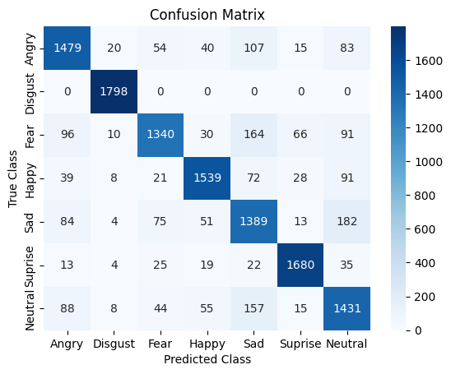
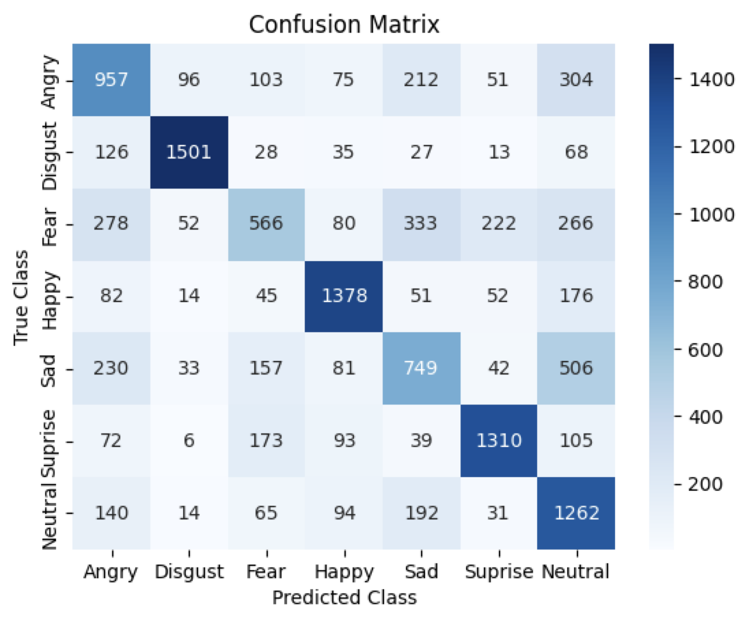
MODELING
Comparing Confusion Matrices
WITHOUT AUGMENTATION
CONFUSION MATRIX
WITH AUGMENTATION
CONFUSION MATRIX
SAD is the expression that is most often confused, with 182 images misclassified as NEUTRAL.
On the other hand, the model predicts SAD for FEAR (164 misclassified images) and NEUTRAL (157 misclassified images).
SAD is the expression that is most often confused, with 506 images misclassified as NEUTRAL, and 203 misclassified as ANGRY.
FEAR is also largely misclassified: 278 times as ANGRY, 333 times as SAD, and 266 times as NEUTRAL.
ANGRY is confused with NEUTRAL 304 times.
Notes:
Omar:
On this slide, we compare the performance of our model without data augmentation and with data augmentation.
We use confusion matrices to visualize and analyze the classification results of both models.
The left confusion matrix represents the model’s performance without any data augmentation, which surprisingly outperformed the model that used data augmentations.
Despite the high validation accuracy of around 84%, there are several misclassifications, particularly with the expressions SAD with NEUTRAL and FEAR, and NEUTRAL with SAD.
ANGRY and DISGUST are generally well classified, with only minor misclassifications.
Although there are occasional misclassifications of other expressions, SAD stands out as the most problematic.
The right confusion matrix represents the model's performance after applying data augmentation techniques.
Despite augmentation, SAD remains the most confused expression, with 506 images misclassified as NEUTRAL and 203 as ANGRY.
FEAR is frequently misclassified as ANGRY, SAD, and NEUTRAL.
ANGRY is confused with NEUTRAL 304 times.
Augmentation seems to have increased the model's sensitivity to certain expressions, leading to higher confusion in some cases but possibly improving general robustness.
It was surprising to us that the augmentation of the data did not substantially improve the model’s accuracy.
There is a need to refine the augmentation techniques or consider additional methods to improve classification accuracy for these expressions.
Further investigations might be needed to understand why certain expressions like SAD and FEAR are most prone to confusion.

Slide 12
DISCUSSION AND CONCLUSIONS
Summarizing Key Findings and Further Considerations
DATA AUGMENTATION
YES, NO, AND WHY
USE CASES
FOR EMOTION CLASSIFICATION
ETHICS AND LIMITATIONS
CONCLUSIONS
Our results show that the performance of both the baseline and hyperparameter-tuned model decreases when we adopt data augmentation.
Possible explanations include:
INADEQUATE AUGMENTATION PARAMETERS
MODEL COMPLEXITY
TRAINING INSTABILITY
OVERFITTING TO AUGMENTED DATA
Whether to adopt data augmentation, might also depend on the specific model task.
Use cases for ADOPTING augmentation:
DETECT SECURITY THREATS
SOCIAL MEDIA CONTENT MODERATION
HEALTHCARE DIAGNOSTICS
AUTOMOTIVE DRIVER MONITORING
Use cases for NOT adopting augmentation:
PASSPORT SECURITY CHECK
HIGH-STAKES LEGAL IDENTIFICATIONS
FORENSIC ANALYSIS
When performing emotion classification, it’s crucial to consider the potential introduction of:
BIAS IN TRAINING DATA
PRIVACY CONCERNS
Additionally, we acknowledge our model approach limitations:
CONSIDER ADOPTING MORE AUGMENTATION TECHNIQUES
BRIGHTNESS
CONTRAST
POTENTIAL OVERFITTING TO SPECIFIC EMOTIONAL EXPRESSIONS
TESTING ACCURACY
WITHOUT WITH
AUGMENTATION AUGMENTATION
84.6% 61.4%
IMPACT OF DATA AUGMENTATION ON TRAINING ACCURACY. Data augmentation significantly reduced training accuracy, making training more challenging.
EFFECT ON VALIDATION AND TESTING ACCURACY. Augmentation led to lower validation and testing accuracy, indicating poor alignment with the dataset.
CONFUSION IN EMOTION CLASSIFICATION. SAD and FEAR emotions were frequently misclassified, especially with augmentation.
MODEL PERFORMANCE WITHOUT AUGMENTATION. The hyperparameter-tuned model without augmentation performed best across all phases.
Notes:
Omar:
On this slide we show some of our conclusions and highlights of our investigation when building this model
Our results show that the performance of both the baseline and hyperparameter-tuned model decreases when we adopt data augmentation.
Some of our possible explanations for this include:
Inadequate augmentation parameters: the chosen parameters might not be optimal for the given data and task we were working with.
Model Complexity: the augmentation might increase the complexity that the model cannot handle effectively.
Training Instability: Augmentation introduced instability during training, leading to poorer performance.
Overfitting to augmented data: its possible that the model might overfit to the augmented data, reducing its ability to generalize.
Whether or not to adopt data augmentation might also depend on the specific model task.
For example, use cases that would make sense for adopting data augmentation would include scenarios that involve high variability in the images:
Detect Security Threats
Social Media Content Moderation
Healthcare Diagnostics
Automotive Driver Monitoring
Cases where data augmentation might not be appropriate would include scenarios where we are working with images that are fairly standardized/cleaned such as:
Passport Security Check
High-Stakes Legal Identifications
Forensic Analysis
There are also some ethical considerations and limitations we’ve considered when building this model. For instance
Bias in Training Data: Models trained on biased datasets can perpetuate and amplify those biases, leading to unfair or inaccurate emotion classification. As we saw earlier in the presentation, there was an underrepresented class that we had to correct for.
Privacy Concerns: The use of facial recognition technology for emotion classification raises significant privacy issues
Limitations of Augmentation Techniques: While augmentation can improve model robustness, inappropriate or excessive augmentation can degrade model performance and lead to unreliable predictions. This highlights the need for careful parameter tuning and validation.
After looking over our results, we considered using more augmentation techniques, like adjusting for brightness and contrast in the images
We hope this augmentation might help prevent potential overfitting to specific emotional expressions like the HAPPY class that might have been present
So in conclusion
Data augmentation significantly reduced training accuracy, making training more challenging.
Augmentation also led to lower validation and testing accuracy, indicating our augmentation were in poor alignment with the dataset.
SAD and FEAR emotions were frequently misclassified in both all our models, especially with augmentation.
The fine tuned model without augmentation performed best across all phases.

Slide 13
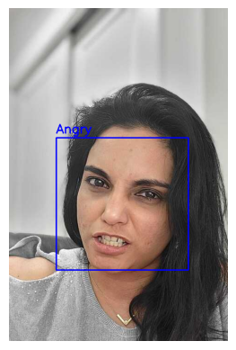
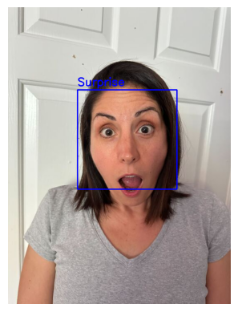
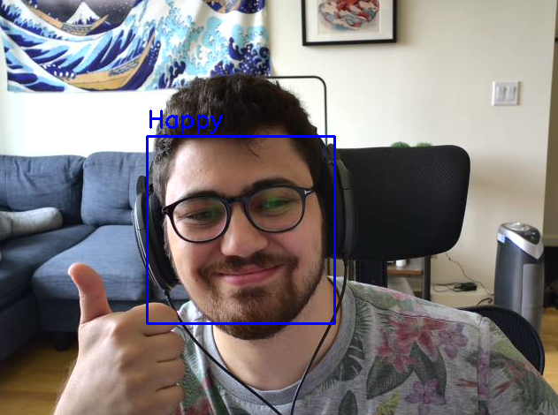
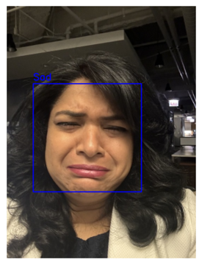
Project Repository Link: https://github.com/DrZubi/MIDS_DATASCI_207
Notes:
Omar:
Thank you all for listening to our presentation!
We also invite you all to try out the models yourself!
There is a live demo feature built into the workbook that allows you to test the models we’ve built.
We hope you gained some key insights into how convolutional neural networks can be used to solve various problems involving images you may encounter during your careers.

Slide 14
TEAM MEMBERS CONTRIBUTION
To the Project
Priya Iragvarupu
Sowjanya Yaddanapudi
CNN Model build and implementations.
Tested different types of data augmentations.
Wrote comments after major steps performed in the Jupyter notebook.
Code debugging
Draw conclusions based on observed results.
Reviewed and participated in team discussions
Worked on the structure of the code and the presentation workflow.
Conducted weekly syncs to ensure the project is on track.
Added the class balance, augmentation, hyperparameter tuning and test accuracy for model with Aug.
Created, edited and produced half of the slides, in the presentation.
Francesca Scipioni
Omar Zu’bi
Testing hyperparameter tuning combinations.
Tested different types of data augmentations.
Wrote comments after major steps performed in the Jupyter notebook.
Draw conclusions based on observed results.
Created, edited and produced half of the slides, in the presentation
Data Exploration and Analysis
CNN Model Implementations
Live Demonstration Features
Model Export Processes and Repository Error Troubleshooting
GitHub Repository Management and resolving merge conflicts
Code Debugging

Slide 15
NeurIPS checklist
1. For all authors...
(a) Do the main claims made in the abstract and introduction accurately reflect the paper's contributions and scope? YES
(b) Have you read the ethics review guidelines and ensured that your paper conforms to them? YES
(c) Did you discuss any potential negative societal impacts of your work? YES
(d) Did you describe the limitations of your work? YES
2. If you are including theoretical results... N/A
3. If you ran experiments... N/A
4. If you are using existing assets (e.g., code, data, models) or curating/releasing new assets... N/A
5. If you used crowdsourcing or conducted research with human subjects... N/A

